Slide 1
Neural Networks
Jannes Klaas

Slide 2
Machine Learning
Machine learning is the subfield of computer science that gives computers the ability to learn without being explicitly programmed (Arthur Samuel, 1959).

Slide 3
Machine Learning
Data
Predictions

Slide 4
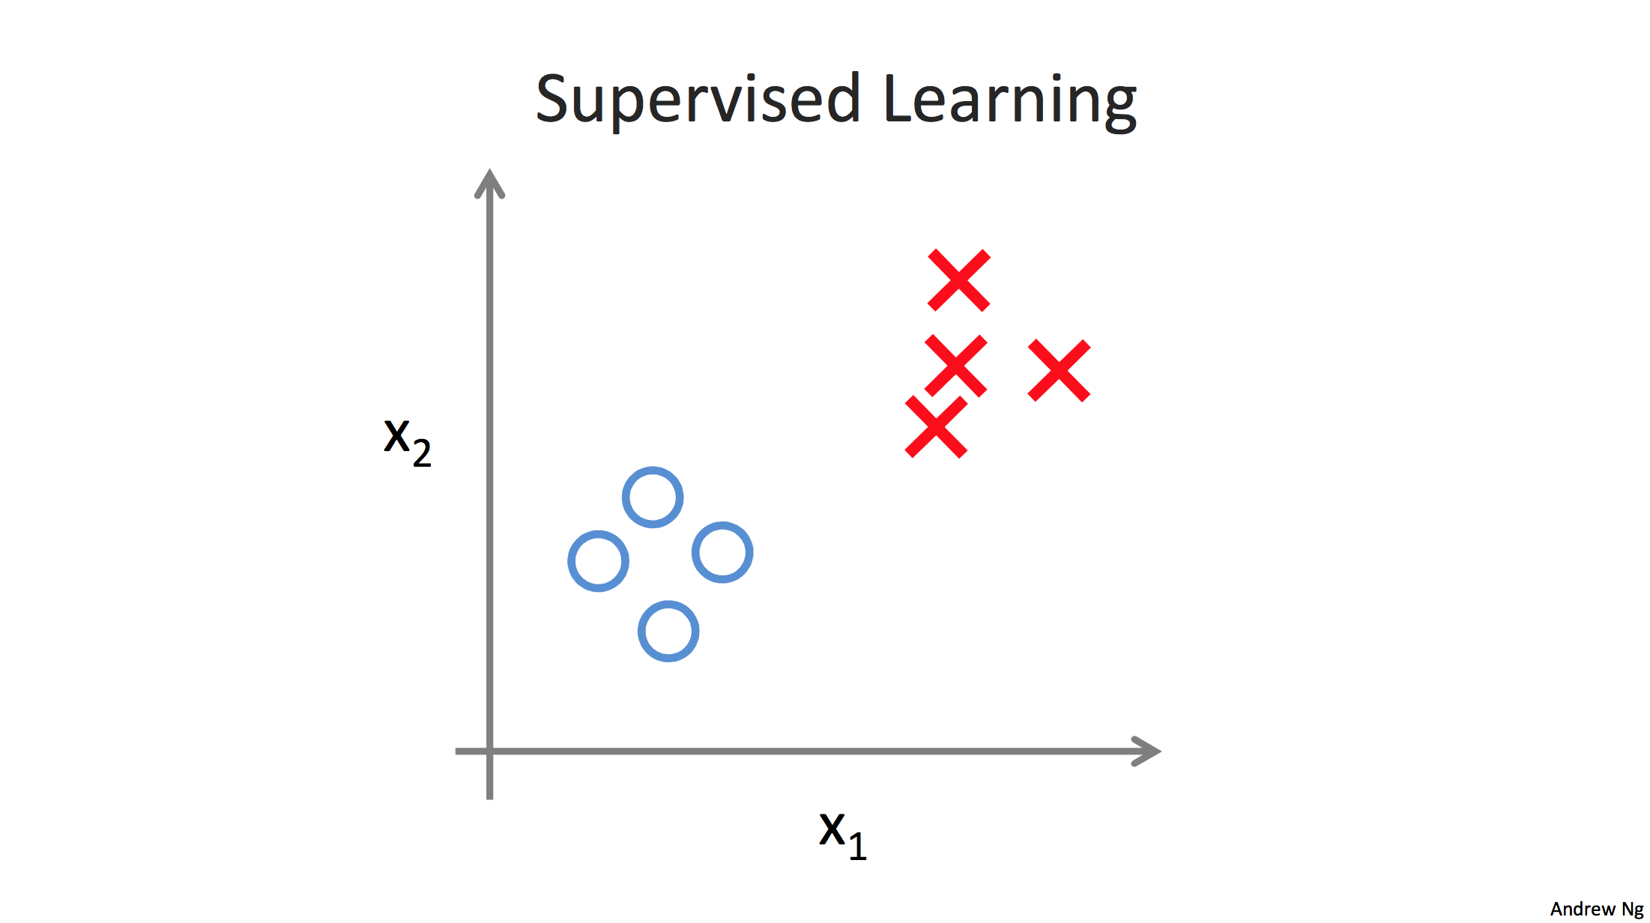

Slide 5
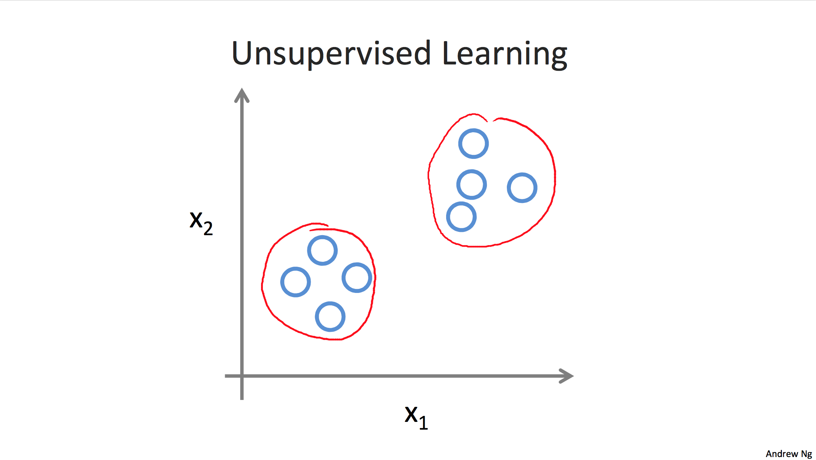

Slide 6
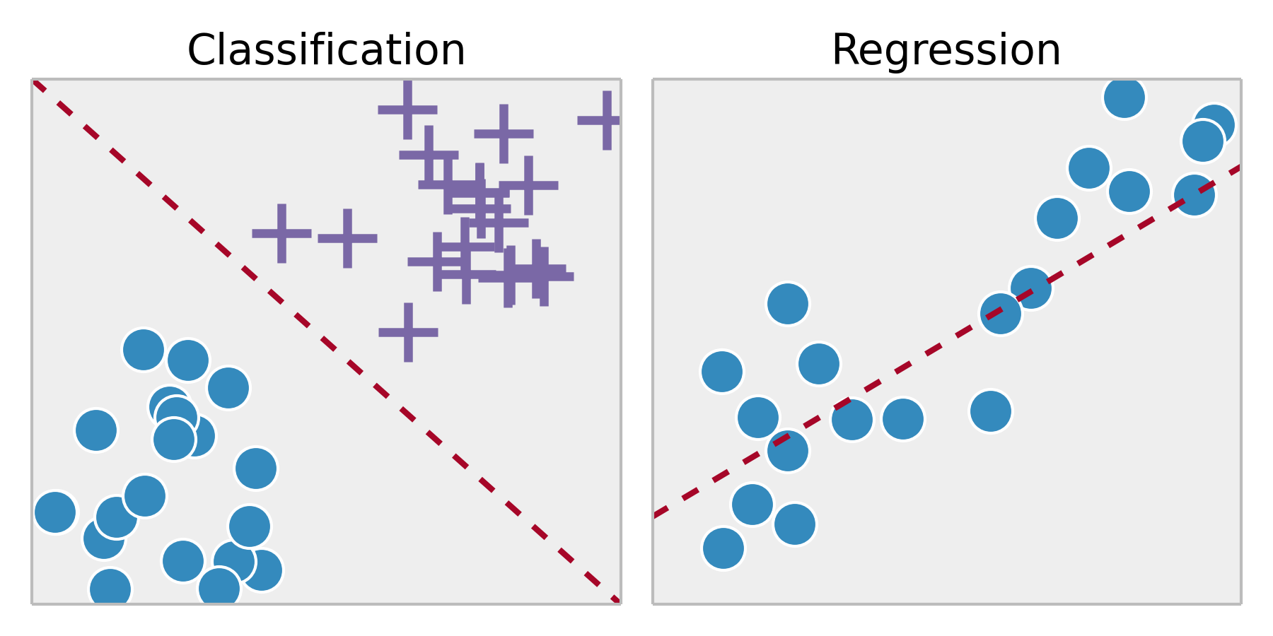

Slide 7
Model representation
X = feature vector (sometimes vectors stacked as matrix for all samples)
θ = Parameter vector
hθ(X) = prediction = ŷ

Slide 8
Model representation example, linear regression
ŷ = b + m*x
hθ(X) = θ*X
θ = [b,m]; X = [1,x]

Slide 9
Logistic regression Sigmoid function (II)
Sigmoid(0) = 0.5
Sigmoid(inf) = 1
Sigmoid(-inf) = 0
You can think of it as the confidence that the correct answer is 1
LR: Output = Sigmoid(X*Parameter)

Slide 10
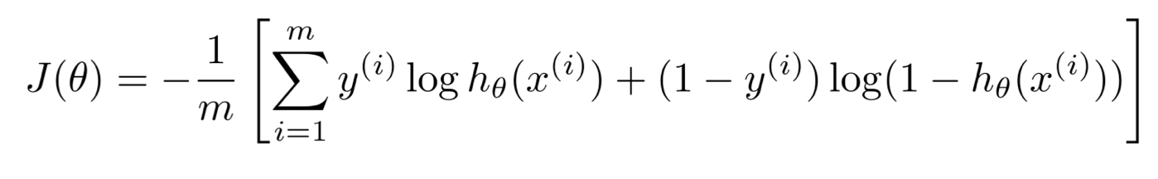

Cost function
How bad are we doing?
Goal: reduce overall cost
In linear regression $J={\left(y −ŷ\right)}^{2}$
In logistic regression: cross entropy loss:

Slide 11
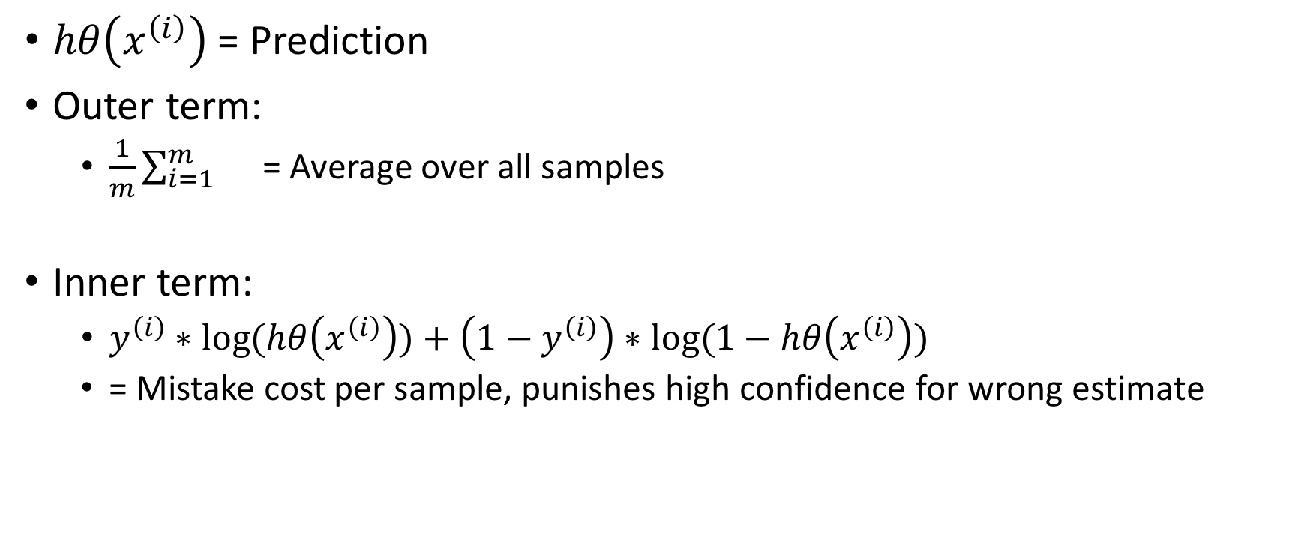
Cross entropy loss deconstructed
$hθ\left(x^{\left(i\right)}\right)$ = Prediction
Outer term:
$\frac{1}{m}\sum_{i=1}^{m}{}$ = Average over all samples
Inner term:
$y^{\left(i\right)}∗log⁡(hθ\left(x^{\left(i\right)}\right))+\left(1−y^{\left(i\right)}\right)∗log⁡(1−hθ\left(x^{\left(i\right)}\right))$
= Mistake cost per sample, punishes high confidence for wrong estimate

Slide 12

Cross entropy loss deconstructed: Example
$hθ\left(x^{\left(i\right)}\right)$ = Prediction = 1
$y^{\left(i\right)}=0$
Inner term:
$y^{\left(i\right)}∗log⁡(hθ\left(x^{\left(i\right)}\right))+\left(1−y^{\left(i\right)}\right)∗log⁡(1−hθ\left(x^{\left(i\right)}\right))$
1$∗log⁡(0)+\left(1−0\right)∗log⁡(1−0)$
1*Inf + 1*0
Inf + 0 = inf

Slide 13

Cross entropy loss deconstructed: Example II
$hθ\left(x^{\left(i\right)}\right)$ = Prediction = 1
$y^{\left(i\right)}=1$
Inner term:
$y^{\left(i\right)}∗log⁡(hθ\left(x^{\left(i\right)}\right))+\left(1−y^{\left(i\right)}\right)∗log⁡(1−hθ\left(x^{\left(i\right)}\right))$
1$∗log⁡(1)+\left(1−1\right)∗log⁡(1−1)$
1*0+0*Inf
0 + 0 = inf

Slide 14
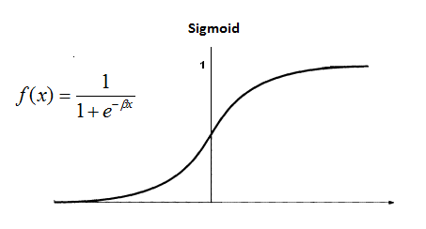
Logistic regression Sigmoid Function
Outputs values between 0 and 1
‘Maps’ linear values to prediction

Slide 15
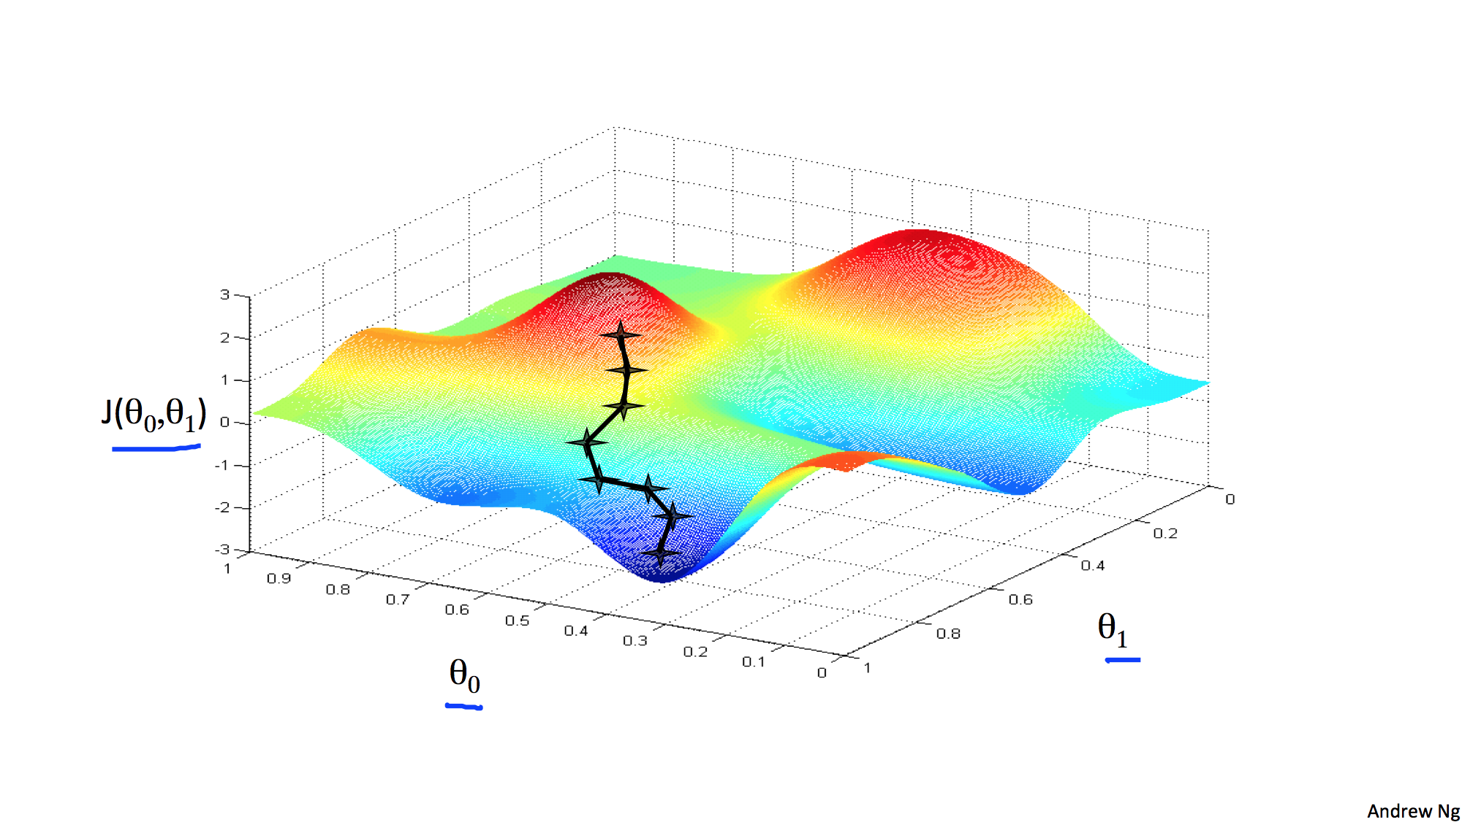
Gradient descent

Slide 16
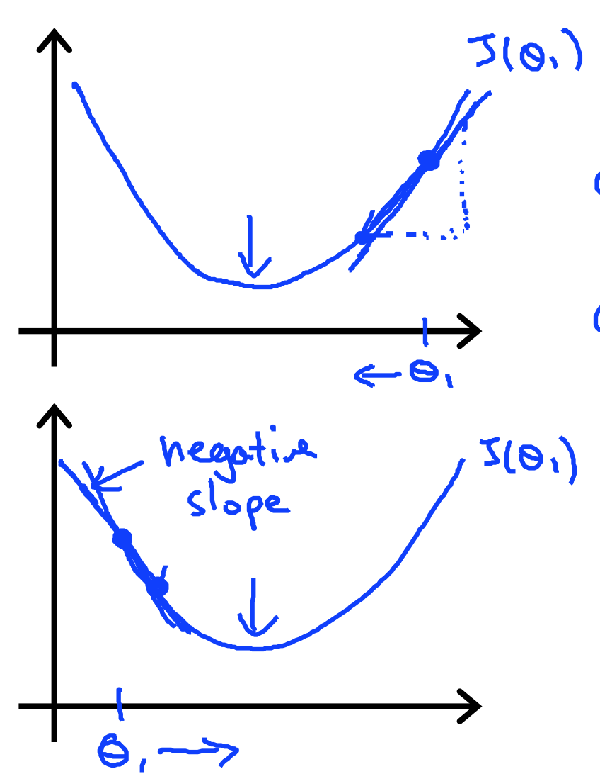
Gradient descent II
Follow gradient down
Gradient = derivative of cost function
Adjust theta by – slope
The closer you get to the minimum you get, the ‘flatter’ it gets and you have to do less changes

Slide 17

Logistic regression gradient
Derivative = $\left(y−hθ\left(x\right)\right)∗x$
Repeat until converges:
$θ:=θ−α∗Derivative$
⍺ -> Learning rate
‘Slows down’ learning, so we don’t ‘jump over’ the minimum.

Slide 18
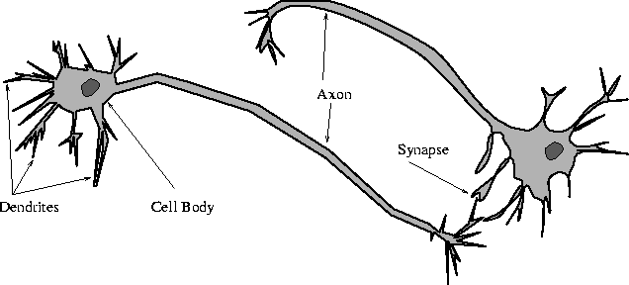
Neural Network (Biology)

Slide 19
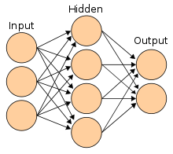
Neural Network (CS)

Slide 20
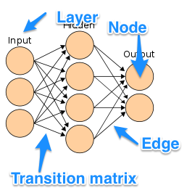
Neural Network (CS) II

Slide 21
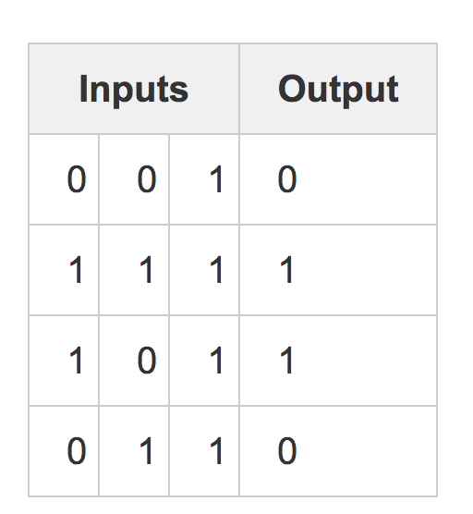
NN in action!
NN example byAndrew Trask

Slide 22
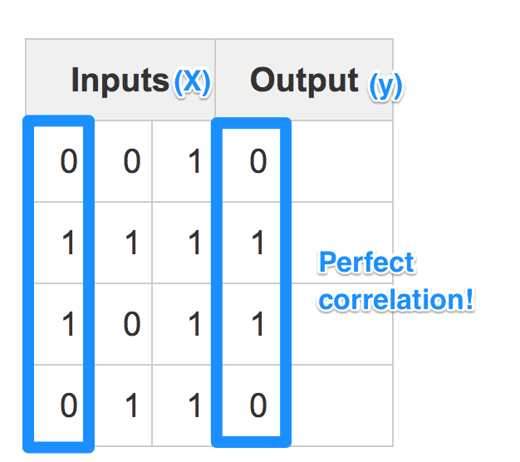
NN in action II

Slide 23
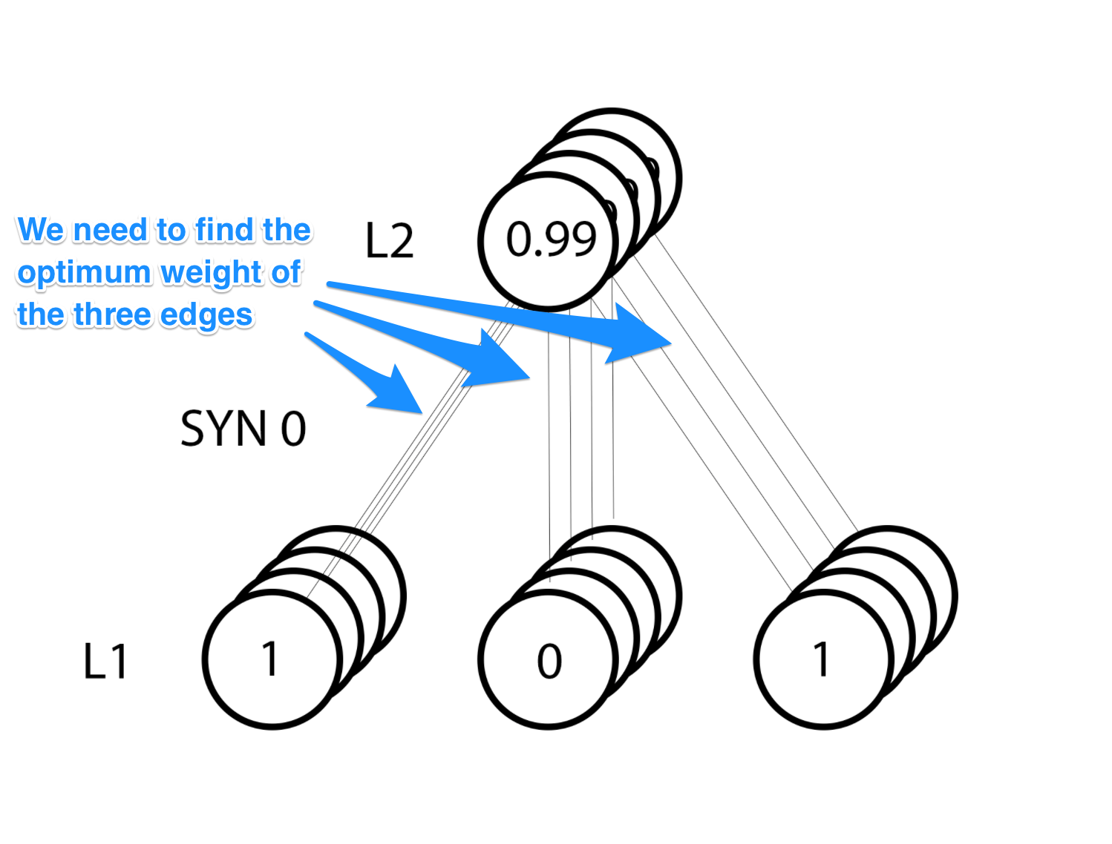

Slide 24
Forward propagation
Layer_0 * syn0 = input_layer_one
value layer 1 = activation_function(input_layer_one)
syn0: Weight function. Strength of the connection
Like dendrites in biology!
activation_function() = Turns input into ‘level of activity’
What happens inside the neuron
We use the sigmoid function
Others: thanh, softmax, and many more…

Slide 25

Update weights according to gradient (Backpropagation)
NN error =${\text{(}\text{hθ}\text{(}\text{X}\text{)} \text{−} \text{y})}^{2}$
NN derivative = $\left(y−hθ\left(x\right)\right)∗x∗Sigmoid_Derivative(hθ\left(x\right))$
Intuition: Move in direction of error
But if we where really confident about it don’t change much

Slide 26
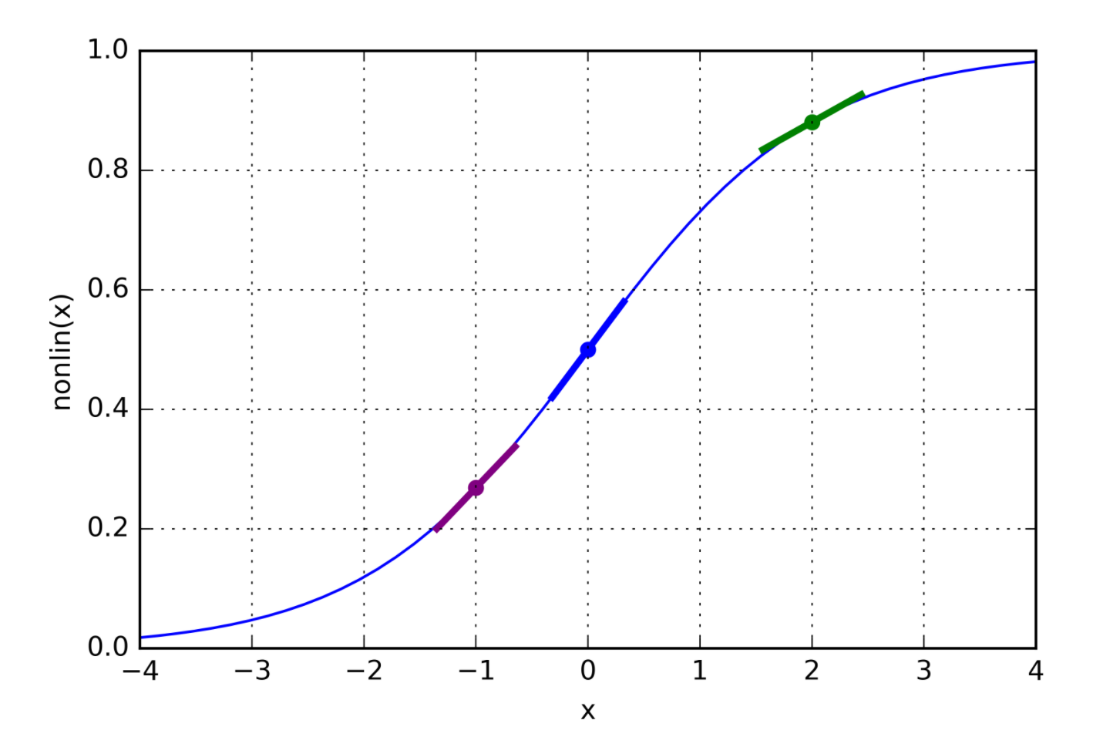
Sigmoid derivatives

Slide 27
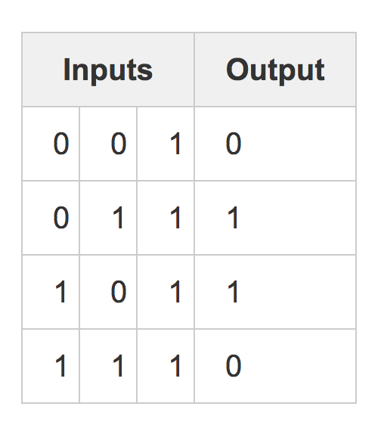
3 Layer Network for a harder problem

Slide 28
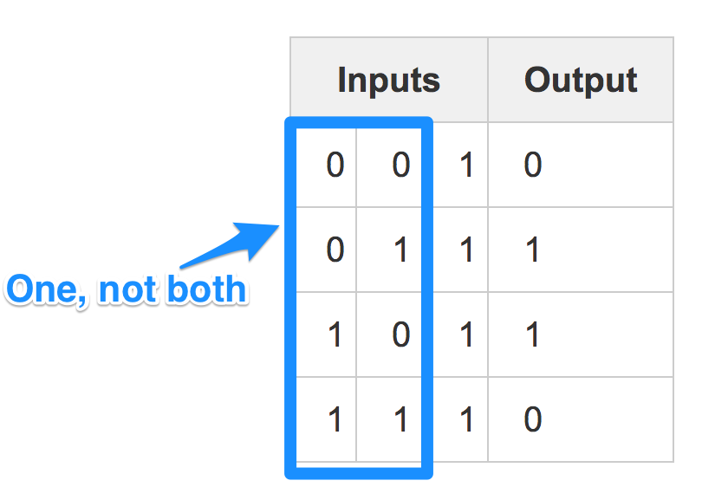
3 Layer Network for a harder problem

Slide 29
PSA
Combination of data makes info, not a single point!

Slide 30
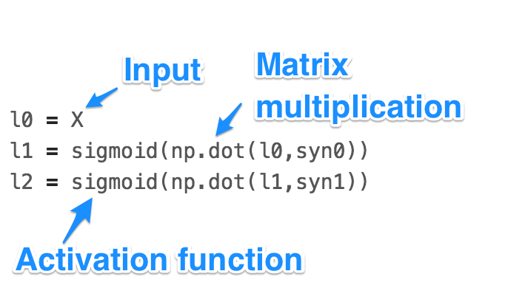
Feed forward

Slide 31
Backpropagation
What is the error at the hidden layer?
The weighted contribution to the error of the output layer!

Slide 32
DEMO

Slide 33
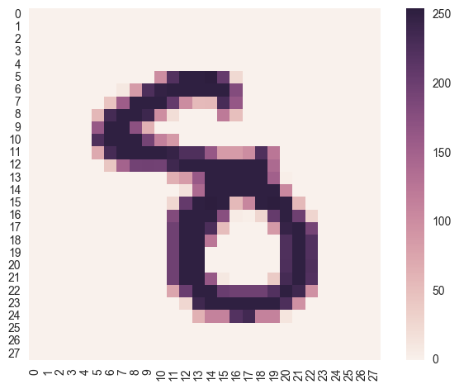
MNIST
Handwritten numbers
0 to 9
28x28 pixels
Labeled dataset

Slide 34

⍺ = Learning rate
Influences the step size of gradient descent
Too large and we might overshoot and miss the minimum
Too small and training is very slow

Slide 35
MNIST NN Design
One vs All classification
e.g. 8 = [0,0,0,0,0,0,0,0,1,0]
4 Layers
Input (l0): 748 Nodes
Hidden1 (l1) : 400 Nodes
Hidden2 (l2): 400 Nodes
Output (l3): 10 Nodes

Slide 36
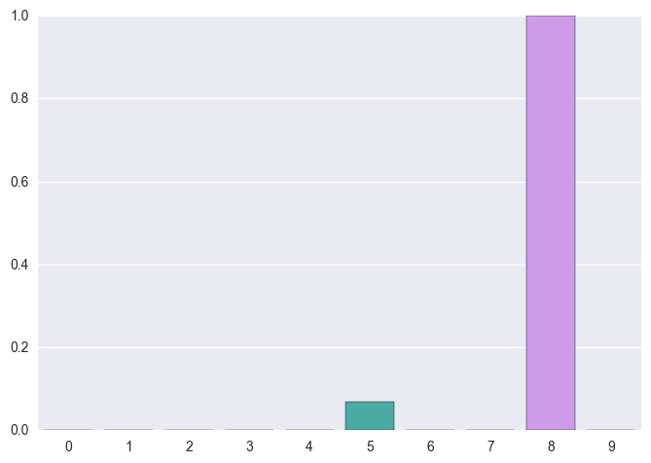
Output for example:
Most likely an 8
Small chance for a 5

Slide 37
DEMO

Slide 38
There is more to explore!
Regularization
To avoid overfitting, punish extreme edge weights
Bias Units
Add 1 to feature vector for every layer (like y intercept)
Dropout
Randomly remove nodes to avoid overfitting in large networks
GPU compatibility
Train faster using GPUs

Slide 39
Thank you for coming
Please don’t build Skynet

Slide 40
Credits
Gradient descent graphics: Andrew Ng
Classification vs Regression graphic: Cyrelle Rossant
Simple NN code: Andrew Trask

